Slide 1
Input File Handling
Diandian Chen
June 15, 2018

Slide 2
Purpose
To obtain the same result for board implementation as from simulation, we should make sure input file is read in the same way
For simulation, input file is read by Verilog system function $readmemh() into a register array that only exists in simulation; and for board implementation, input file is sent using RealTerm via UART
Such difference can cause discrepancy between how input is organized and fed into each neuron every cycle between simulation and board implementation: 1. RealTerm reads hex data digit by digit, line by line, while $readmemh() reads designated file in a somehow interleaved way if reg array and file format are not well set 2. $readmemh() directly reads ASCII number text as hex number, while RealTerm reads text by its encoding code (e.g. number “0” in text is read as hex “30” if text is encoded in ASCII)
To make sure input file is read in the same way, we need to organize text file in an appropriate format, with appropriate encoding

Slide 3
Method
Originally our DNN needs 128 bits per clock, and in simulation the input file is loaded into a register array as source of input, while in real UART transmission the input file is read as is digit by digit by RealTerm. It seems input file can be read in the same way by $readmemh() and UART transmission if register loaded by $readmemh() is equally wide as or wider than bits per line in input file (currently, due to that our latest DNN needs 256 bits per clock, I changed register width in register array to 256b, and there are 32 hex digits in each line of input file, which is 128 bits per line)
We need to process original input file (one whole image per line -> 784 pixels * 8 bit / pixel per line -> 49 * 128 bits per line) into a new input file organized as 128 bits per line, 49 lines per image
We also need to make sure the processed file is stored as hex encoded, so that RealTerm can send data in the input file as expected

Slide 4
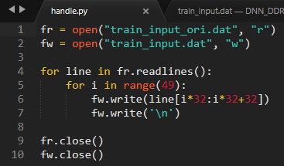
Solution
I used a Python script to convert original input file into a 32-hex-digits-per-line data file (you can find this script in this GITHUB folder)

Slide 5
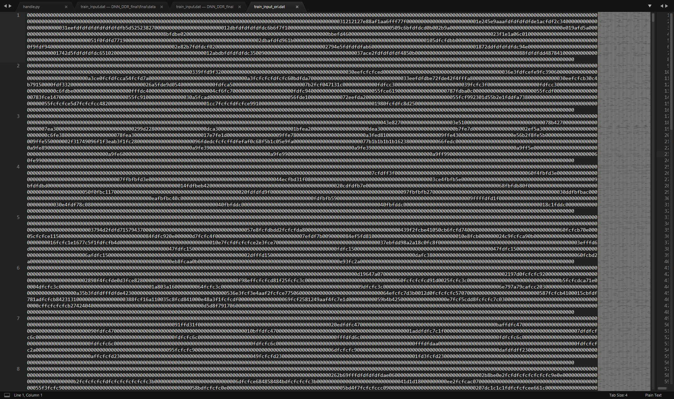
Solution
I store the data file as hex encoded in a somewhat strange way, you can try to do it in a more scientific way
First use the Python script to process the original input file

Slide 6
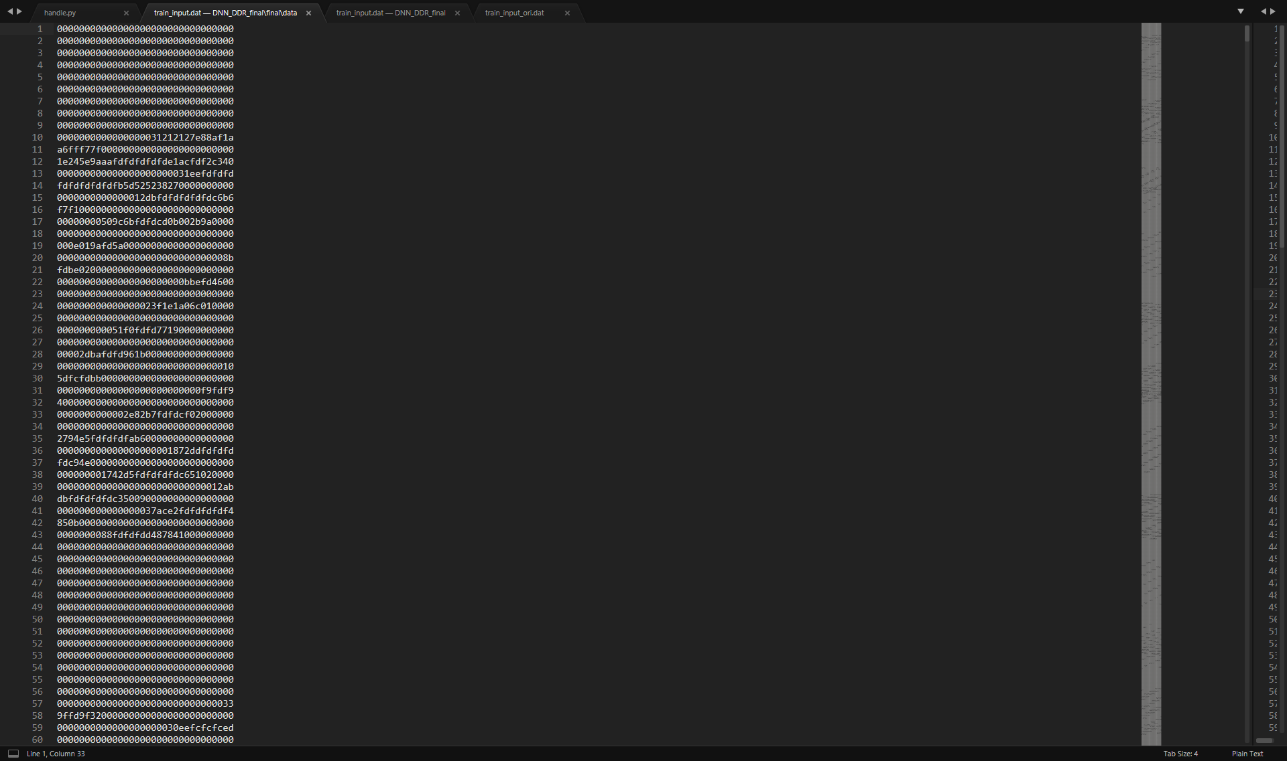
Solution
I store the data file as hex encoded in a somewhat strange way, you can try to do it in a more scientific way
First use the Python script to process the original input file

Slide 7
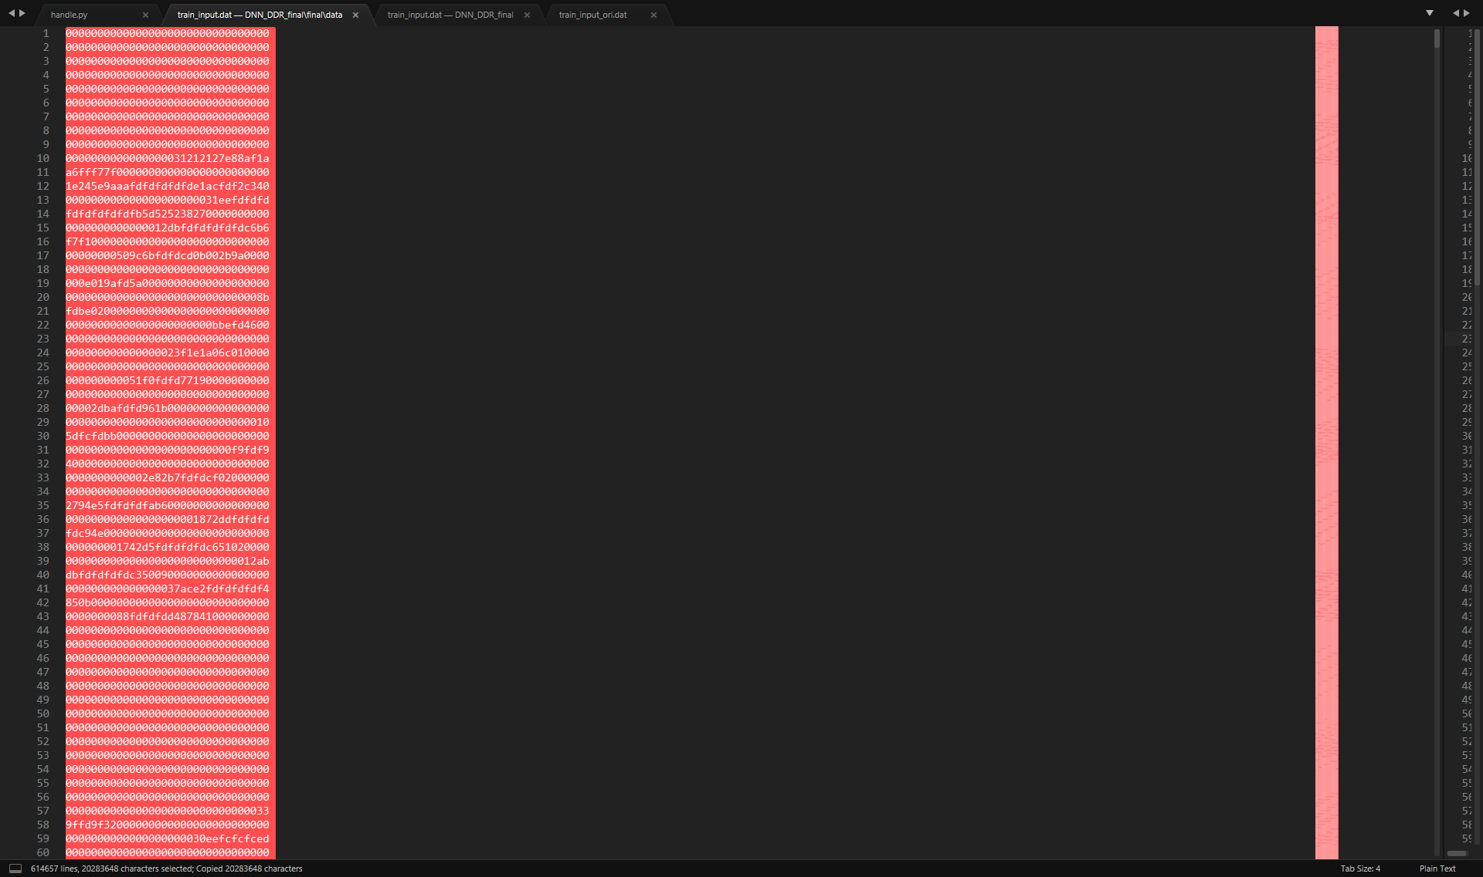
Solution
I store the data file as hex encoded in a somewhat strange way, you can try to do it in a more scientific way
Open the processed file in Sublime Text 3 and copy the whole context (ctrl + A, ctrl + C)

Slide 8
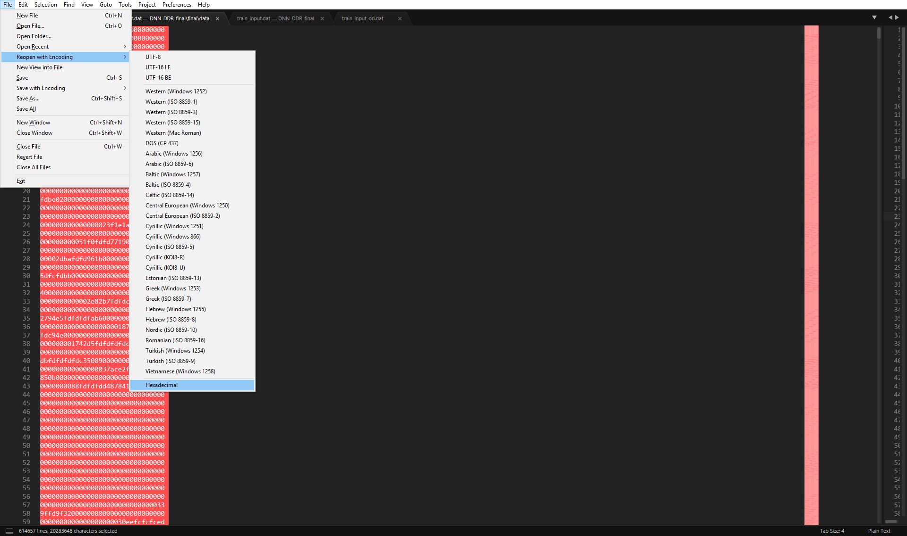
Solution
I store the data file as hex encoded in a somewhat strange way, you can try to do it in a more scientific way
Reopen this file with HEX encoding

Slide 9
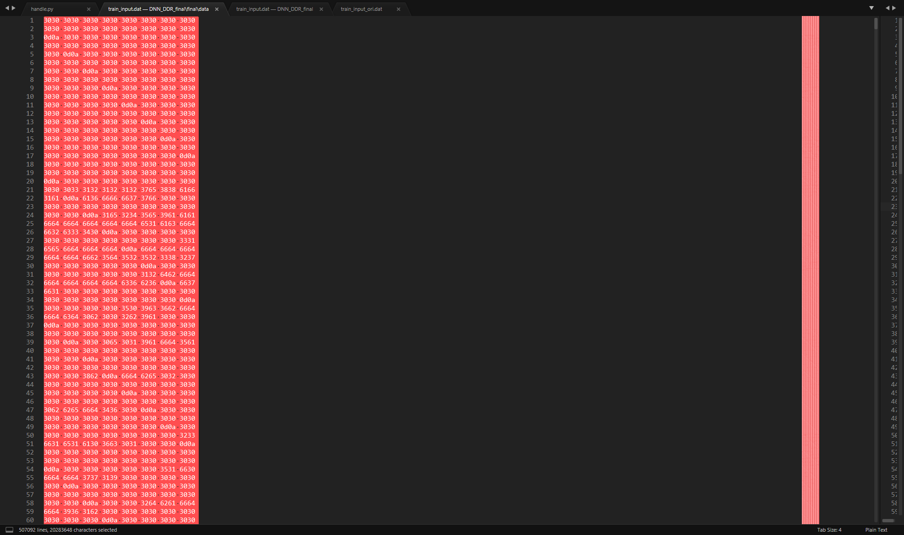
Solution
I store the data file as hex encoded in a somewhat strange way, you can try to do it in a more scientific way
You can see totally different context with HEX encoding. Again select all and paste (ctrl + A then ctrl + V)

Slide 10
Solution
I store the data file as hex encoded in a somewhat strange way, you can try to do it in a more scientific way
Now previous content is pasted with HEX encoding

Slide 11
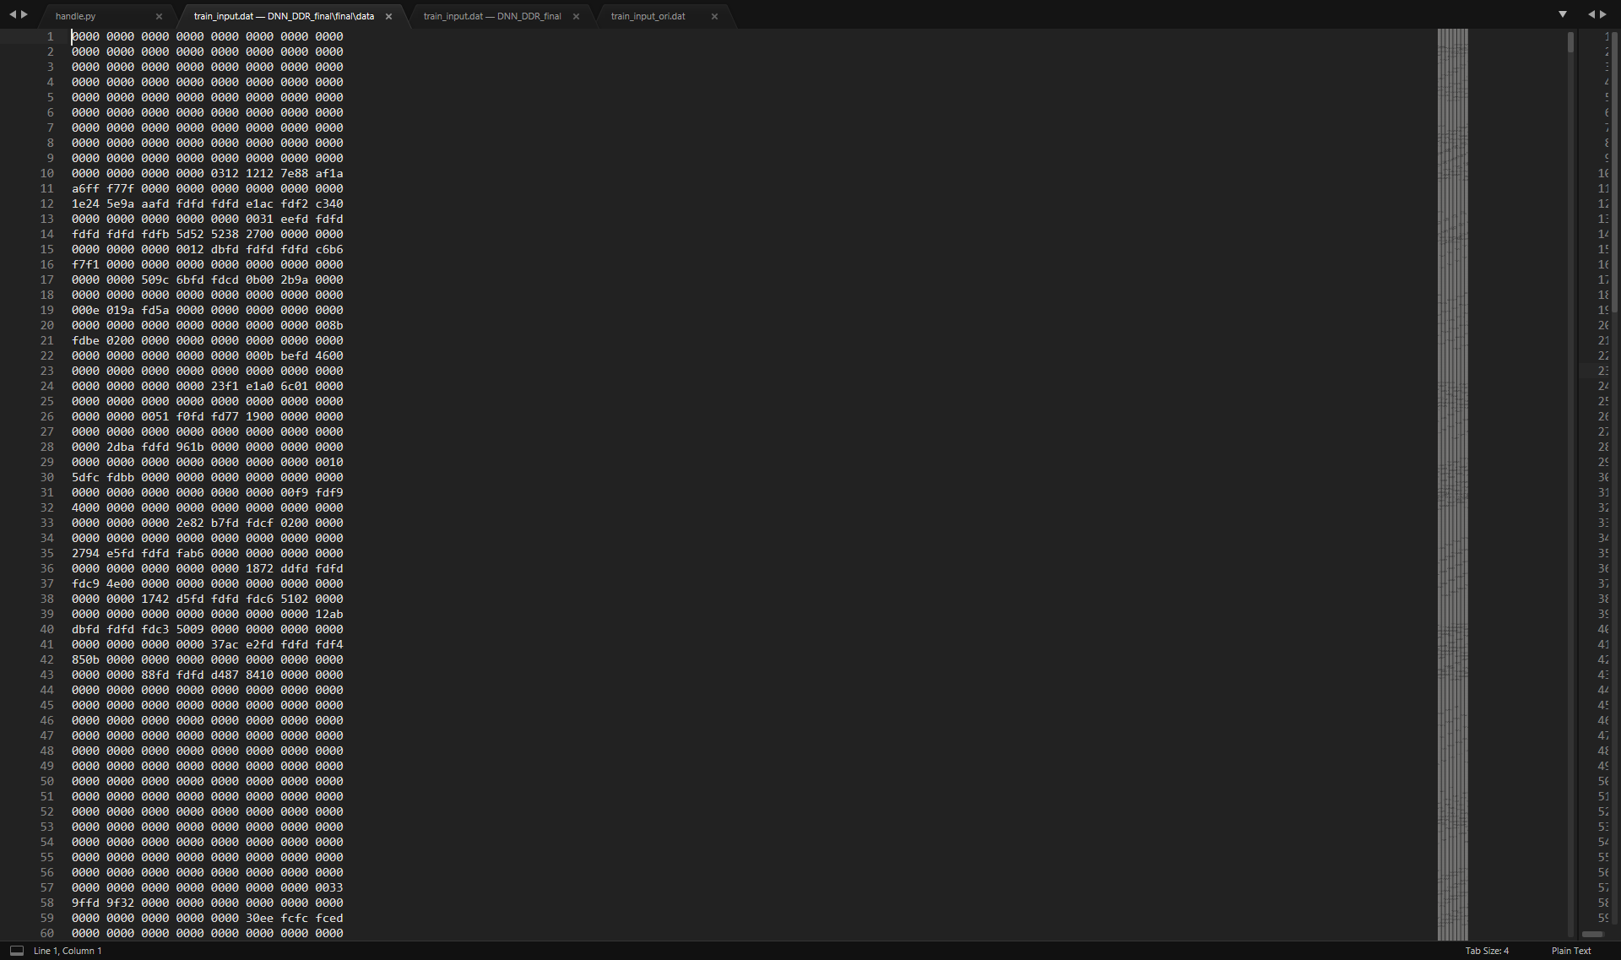
Solution
I store the data file as hex encoded in a somewhat strange way, you can try to do it in a more scientific way
If you close it and open it again, you can see now the whole context is organized in HEX style too

Slide 12
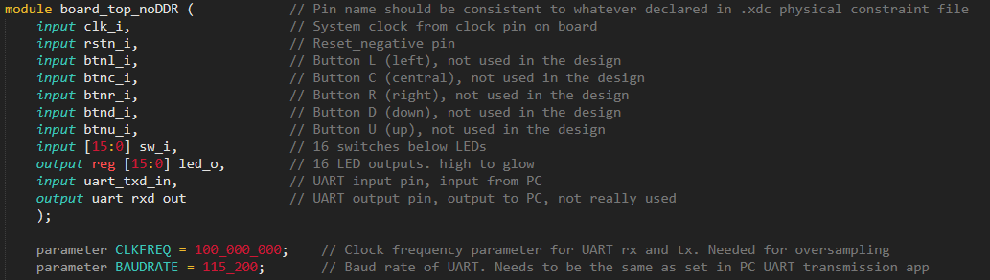
Solution
If you want to verify how data sent via UART is like, you can write a simple top level module, and make sure to:
Include this top level module file and Nexys4DDR_C.xdc into your project
Include clk_i, uart_tx_in and led_o in port I/O of your top level module (names should appear the same as in .xdc file)
Wire dwOut of IOExpansion module to led_o and verify sent data on LEDs

Slide 13
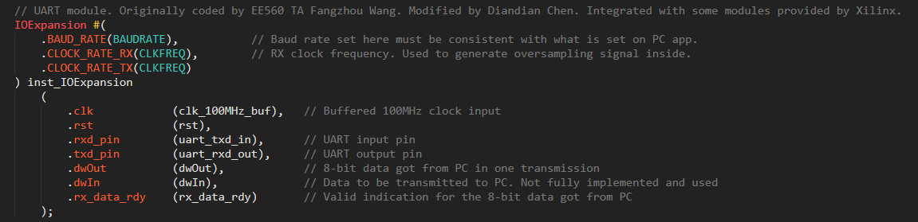
Solution
If you want to verify how data sent via UART is like, you can write a simple top level module, and make sure to:
Include this top level module file and Nexys4DDR_C.xdc into your project
Include clk_i, uart_tx_in and led_o in port I/O of your top level module (names should appear the same as in .xdc file)
Wire dwOut of IOExpansion module to led_o and verify sent data on LEDs

